Slide 1
ISEC Lecture 6 Network Security
Ref: Textbook Chap 5 – Networking and Server Attacks

Slide 2
Objectives
5.1 Describe the different types of networking-based attacks
5.2 Explain how servers are attacked

Slide 3
Media-Based Network Vulnerabilities
Monitoring network traffic
Helps to identify and troubleshoot network problems
Monitoring traffic can be done in two ways
Use a switch with port mirroring
To redirect traffic that occurs on some or all ports to a designated monitoring port on the switch
Install a network tap (test access point)
A separate device that can be installed between two network devices, such as a switch, router, or firewall, to monitor traffic

Slide 4
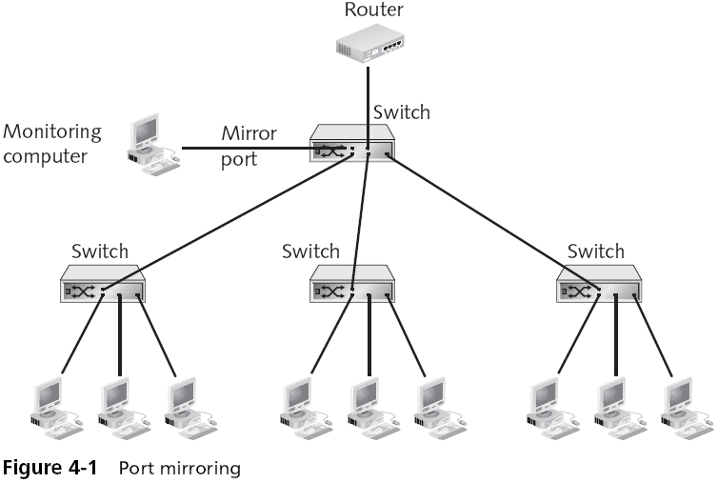

Slide 5
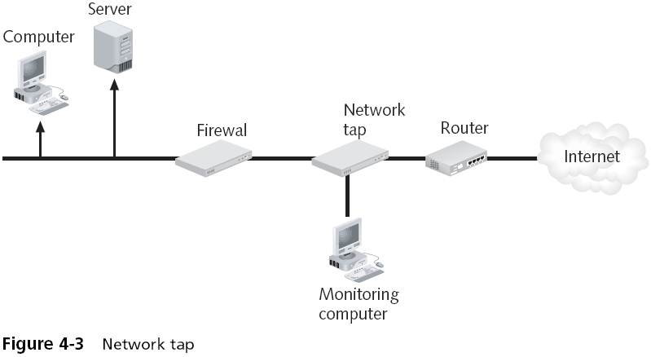
Media-Based Vulnerabilities (continued)

Slide 6
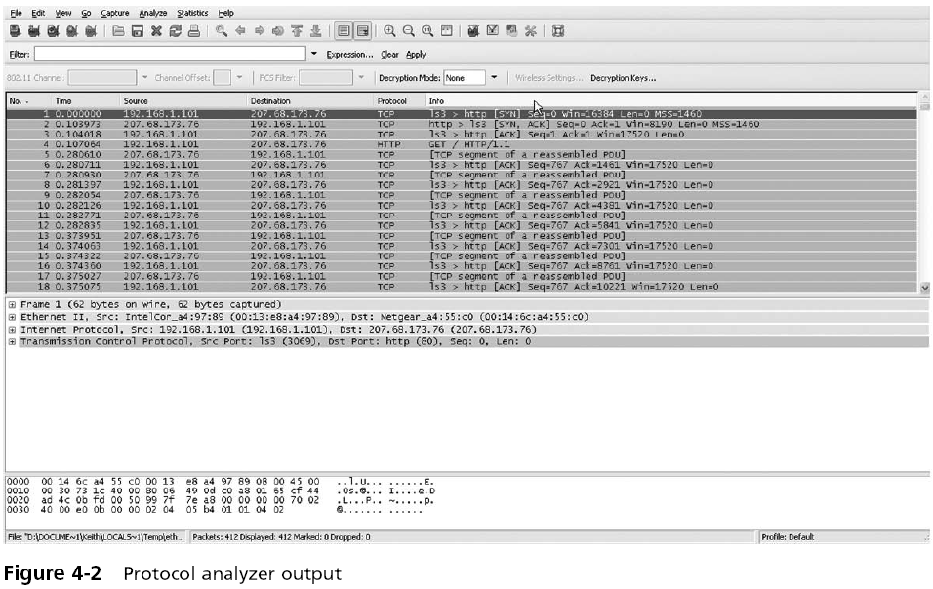

Slide 7
Media-Based Vulnerabilities (continued)
Just as network taps and protocol analyzers can be used for legitimate purposes
They also can be used by attackers to intercept and view network traffic
Attackers can also access the wired network in the following ways:
False ceilings
Exposed wiring
Unprotected RJ-45 jacks

Slide 8
Networking-Based Attacks
There are several attacks that target a network or a process that relies on a network
These attacks can be grouped into:
Interception attacks
Poisoning attacks

Slide 9
Interception
Some attacks are designed to intercept network communications
Three of the most common interception attacks:
Man-in-the-middle attacks
Man-in-the-browser attacks
Reply attacks

Slide 10
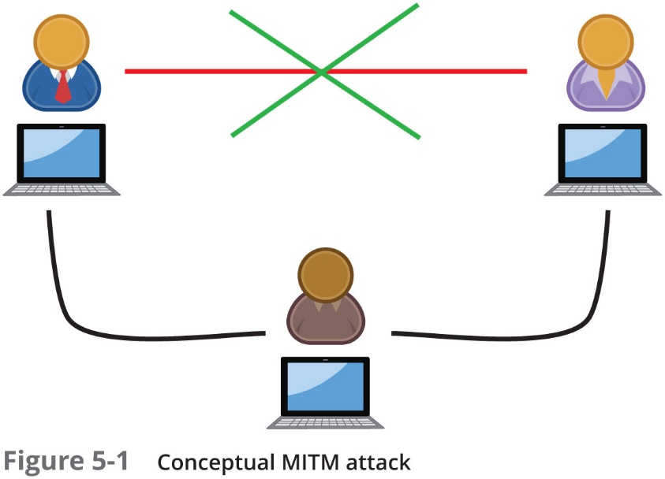
Man-in-the-Middle (M I T M) (1 of 2)
Man-in-the-Middle attacks
Interception of legitimate communication and forging a fictitious response to the sender
Two computers are sending and receiving data with a computer between them
A M I T M could occur between two users
However, many M I T M attacks are between a user and a server

Slide 11
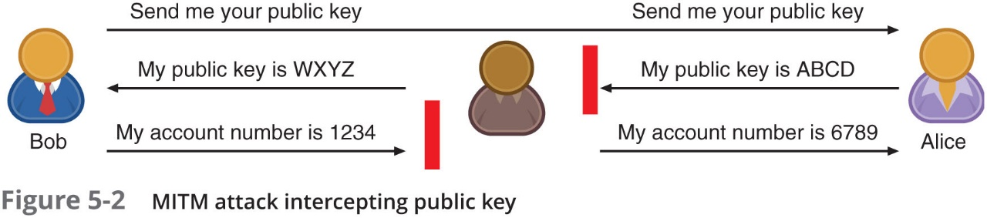
Man-in-the-Middle (M I T M) (2 of 2)

Slide 12
Man-in-the-Browser (M I T B) (1 of 2)
Man-in-the-browser (M I T B) attack intercepts communication between parties to steal or manipulate the data
Occurs between a browser and the underlying computer
A M I T B attack usually begins with a Trojan infecting the computer and installing an “extension” into the browser configuration
When the browser is launched the extension is activated
Extension waits for a specific webpage in which a user enters information such as account number and password for a financial institution
When users click “Submit” the extension captures all the data from the fields on the form
May even modify some of the data

Slide 13
Man-in-the-Browser (M I T B) (2 of 2)
Advantages to a M I T B attack:
Most M I T B attacks are distributed through a Trojan browser extension making it difficult to recognize that malicious code has been installed
An infected M I T B browser might remain dormant for months until triggered by the user visiting a targeted website
M I T B software resides exclusively within the web browser, making it difficult for standard anti-malware software to detect it

Slide 14
Replay
Replay attacks
Attacker makes copy of transmission before sending it to the original recipient
Uses copy at a later time
Example: capturing login credentials
Methods to prevent replay attacks
Both sides can negotiate and create a random key that is valid for a limited period or for a specific process
Use timestamps in all messages and reject any message that fall outside of a normal window of time

Slide 15
Poisoning
Poisoning
The act of introducing a substance that harms or destroys
Three types of attacks inject “poison” into a normal network process to facilitate an attack:
A R P poisoning
D N S poisoning
Privilege escalation

Slide 16
A R P Poisoning (1 of 2)
Address Resolution Protocol (A R P)
If the I P address for a device is known but the M A C address is not, the sending computer sends an A R P packet to determine the M A C address
M A C addresses are stored in an A R P cache for future reference
All computers that “hear” the A R P reply also cache the data
A R P poisoning
Relies upon M A C spoofing, which is imitating another computer by means of changing the M A C address

Slide 17
A R P Poisoning (2 of 2)
Attack | Description
Steal data | An attacker can substitute her own M A C address and steal data intended for another device
Prevent internet access | An attacker can substitute an invalid M A C address for the network gateway so that no users can access external networks
Man-in-the-middle | A man-in-the-middle device can be set to receive all communications by substituting that M A C address
Denial of Service attack | The valid I P address of the target can be substituted with an invalid M A C address, causing all traffic destined for the target to fail

Slide 18
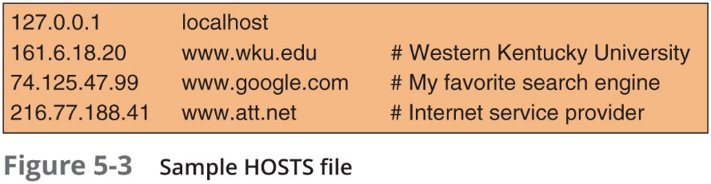
D N S Poisoning (1 of 2)
D N S poisoning
Domain Name System is the current basis for name resolution to I P address
D N S poisoning substitutes D N S addresses to redirect a computer to another device
Two locations for D N S poisoning
Local host table
External D N S server

Slide 19
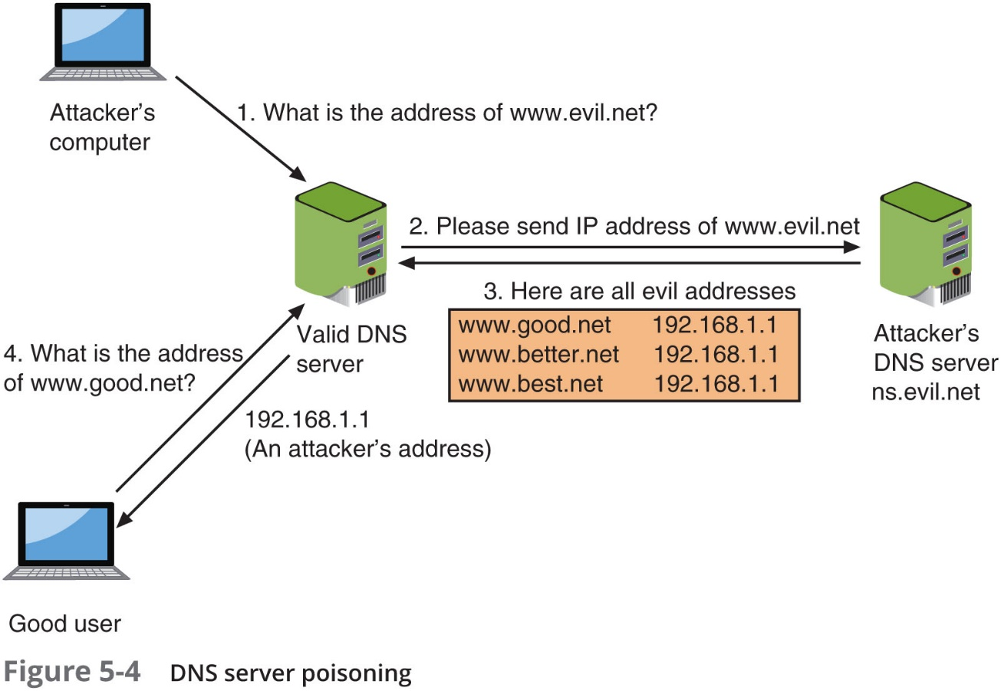
D N S Poisoning (2 of 2)

Slide 20
Privilege Escalation
Access rights
Privileges to access hardware and software resources that are granted to users
Privilege escalation
Exploiting a software vulnerability to gain access to resources that the user normally would be restricted from accessing
Two types of privilege escalation:
When a lower privilege user accesses functions restricted to higher privilege users (sometimes called vertical privilege escalation)
When a user with restricted privilege accesses different restricted functions of a similar user (horizontal privilege escalation)

Slide 21
Server Attacks
A compromised server can provide threat actors with its privileged contents or provide an opening for attacking any of the devices that access that server
Typical server attacks include:
Denial of service
Web server application attacks
Hijacking
Overflow attacks
Advertising attacks
Exploiting browser vulnerabilities

Slide 22
Denial of Service (D o S) (1 of 3)
Denial of service (D o S)
A deliberate attempt to prevent authorized users from accessing a system by overwhelming it with requests
Most D o S attacks today are distributed denial of service (D D o S)
Using hundreds or thousands of devices flooding the server with requests
Smurf attack
An attacker broadcasts a network request to all computers on the network but changes the address from which the request came from (called I P spoofing)
Appears as if victim’s computer is asking for response from all computers on the network
All computers send a response to the victim’s computer so that it is overwhelmed

Slide 23
Denial of Service (D o S) (2 of 3)
D N S amplification attack
Flood a victim by redirecting valid responses to it
Uses publicly accessible and open D N S servers to flood a system with D N S response traffic
S Y N flood attack
Takes advantage of procedures for initiating a session
In a S Y N flood attack against a web server:
The attacker sends S Y N segments in I P packets to the server
Attacker modifies the source address of each packet to computer addresses that do not exist or cannot be reached

Slide 24
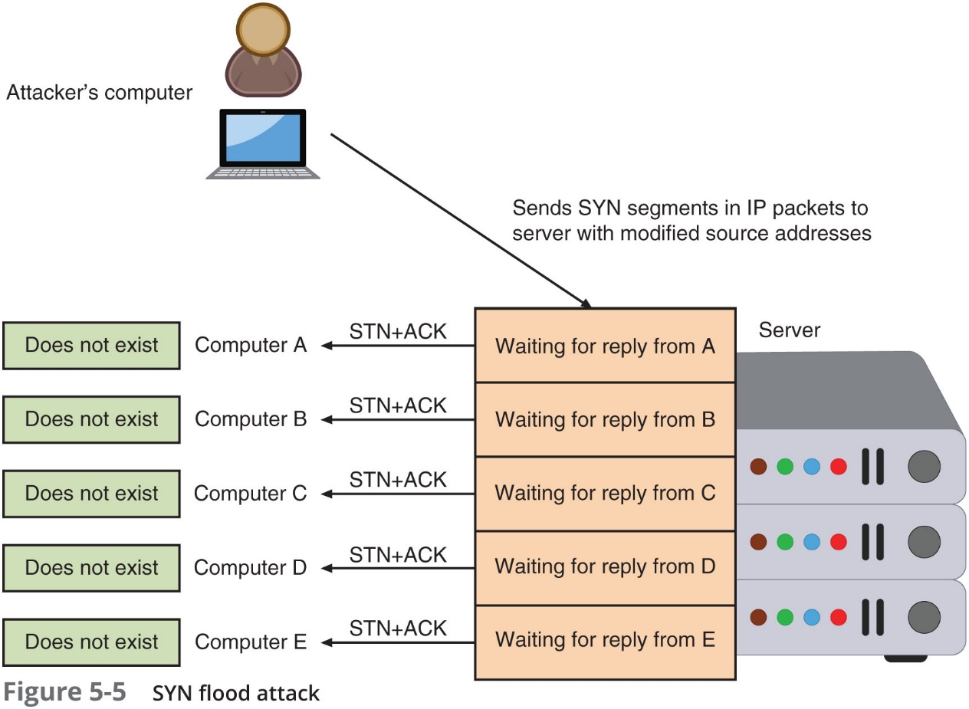
Denial of Service (D o S) (3 of 3)

Slide 25
Web Server Application Attacks (1 of 2)
Securing web applications is more difficult than protecting other systems
Zero-day attack - an attack that exploits previously unknown vulnerabilities, victims have not time to prepare for or defend against the attack
Traditional network security devices can block traditional network attacks, but cannot always block web application attacks
Many network security devices ignore the content of H T T P traffic
Several different web application attacks target the input from users and are grouped into two categories:
Cross-site attacks
Injection attacks

Slide 26
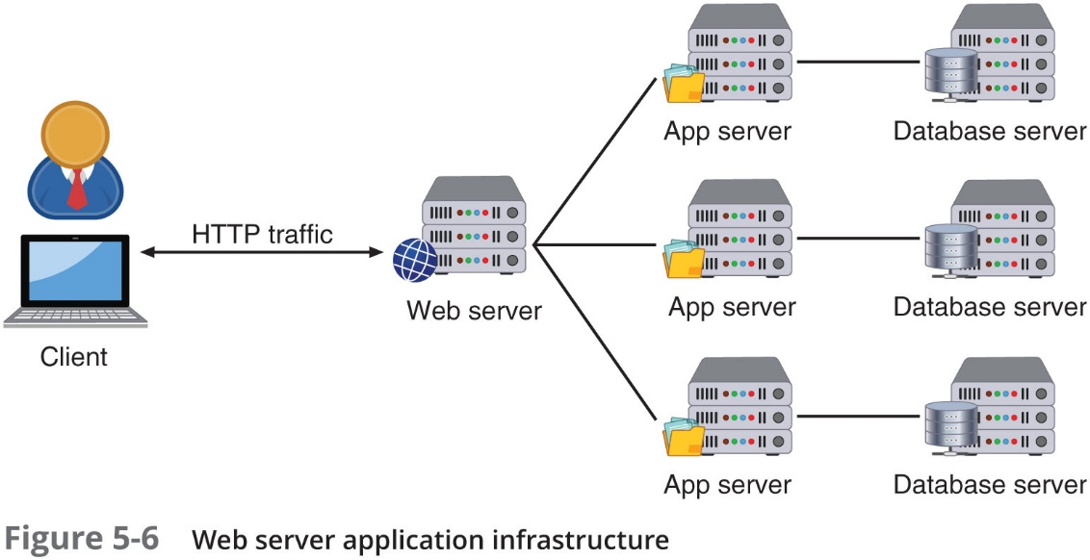
Web Server Application Attacks (2 of 2)

Slide 27
Cross-Site Attacks (1 of 4)
In a cross-site scripting (X S S) attack
The threat actor takes advantage of web applications that accept user input without validating it before presenting it back to the user
When victim visits injected Web site:
Malicious instructions are sent to victim’s browser
Some X S S attacks are designed to steal information:
Retained by the browser when visiting specific sites
An X S S attack requires a website meets two criteria:
Accepts user input without validating it
Uses input in a response

Slide 28
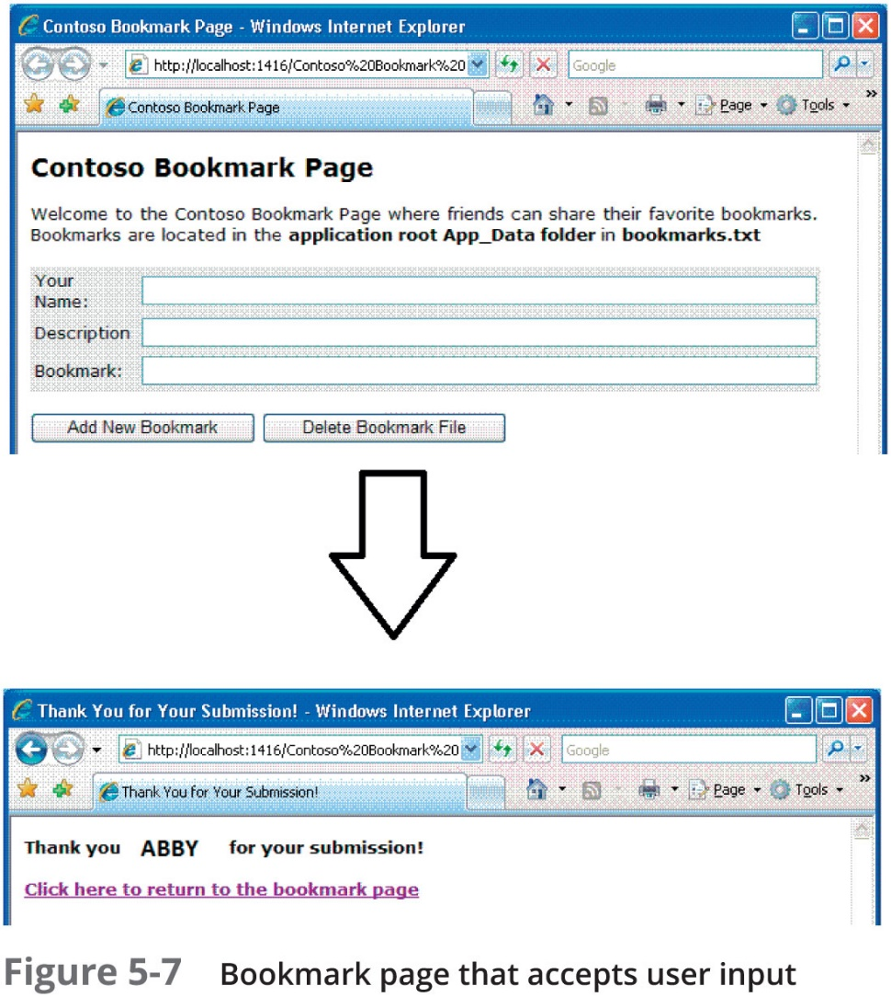
Cross-Site Attacks (2 of 4)

Slide 29
Cross-Site Attacks (3 of 4)
Cross-Site Request Forgery (X S R F)
This attack uses the user’s web browser settings to impersonate that user
If a user is currently authenticated on a website and is tricked into loading another webpage
The new page inherits the identity and privileges of the victim to perform an undesired function on the attacker’s behalf

Slide 30
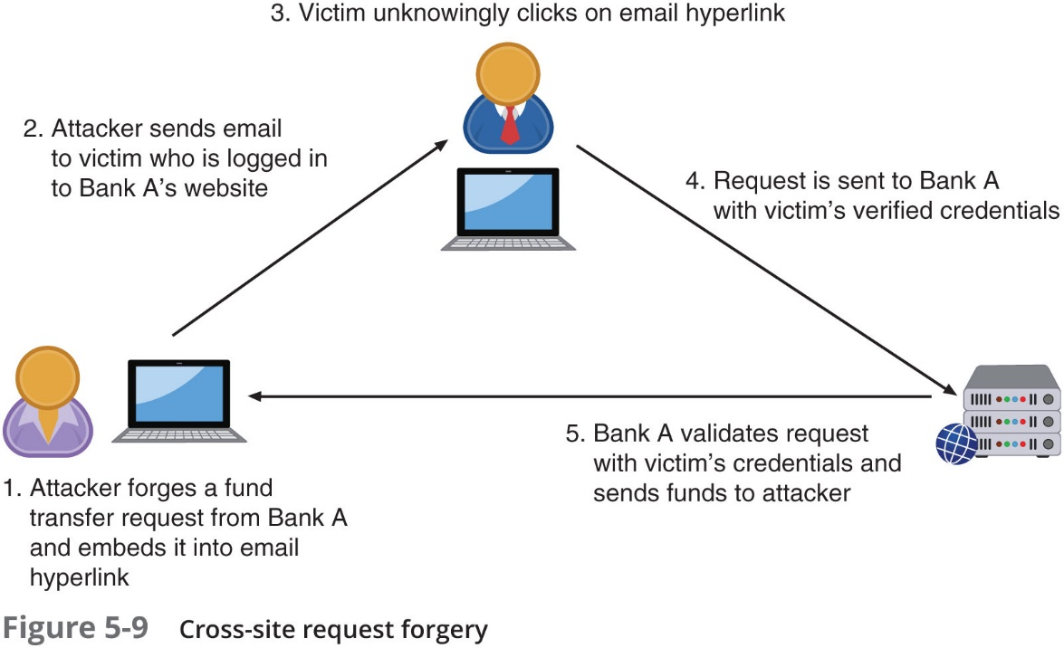
Cross-Site Attacks (4 of 4)

Slide 31
Injection Attacks (1 of 4)
Injection attacks
Introduce new input to exploit a vulnerability
One of the most common injection attacks, called S Q L injection, inserts statements to manipulate a database server
S Q L (Structured Query Language)
Used to view and manipulate data stored in relational database
Forgotten password example:
Attacker enters fictitious e-mail address that included a single quotation mark as part of the data
Response lets attacker know whether input is being validated
Attacker enters email field in S Q L statement

Slide 32
Injection Attacks (2 of 4)
Forgotten password example (continued):
Statement is processed by the database
Example statement:
SELECT fieldlist FROM table WHERE field = ‘whatever’ or ‘a’=‘a’
Result: All user email addresses will be displayed

Slide 33
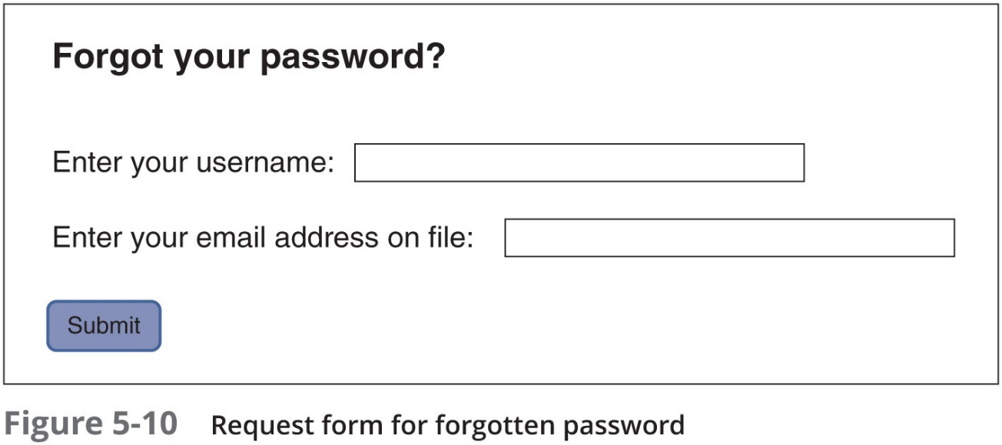
Injection Attacks (3 of 4)

Slide 34
Injection Attacks (4 of 4)
SQL injection statement | Result
whatever’ AND email is NULL;-- | Determine the names of different fields in the database
whatever’ AND 1=(SELECT COUNT(*)FROM tabname);- | Discover the name of the table
whatever’ OR full name LIKE Mia | Find specific users
whatever’; DROP TABLE members; -- | Erase the database table
whatever’; UPDATE members SET email= ‘attacker-email@evil.net’ WHERE email = ‘Mia@good.com’; | Mail password to attacker’s email account

Slide 35
Hijacking
Several server attacks are the result of threat actors “commandeering” a technology and then using it for an attack
Common hijacking attacks include:
Session hijacking
U R L hijacking
Domain hijacking
Clickjacking

Slide 36
Session Hijacking
Session Hijacking
Attacker attempts to impersonate user by stealing or guessing session token
Session token is a random string assigned to an interaction between user and web application
An attacker can attempt to obtain the session token:
By using X S S or other attacks to steal the session token cookie from the victim’s computer
Eavesdropping on the transmission
Guessing the session token

Slide 37
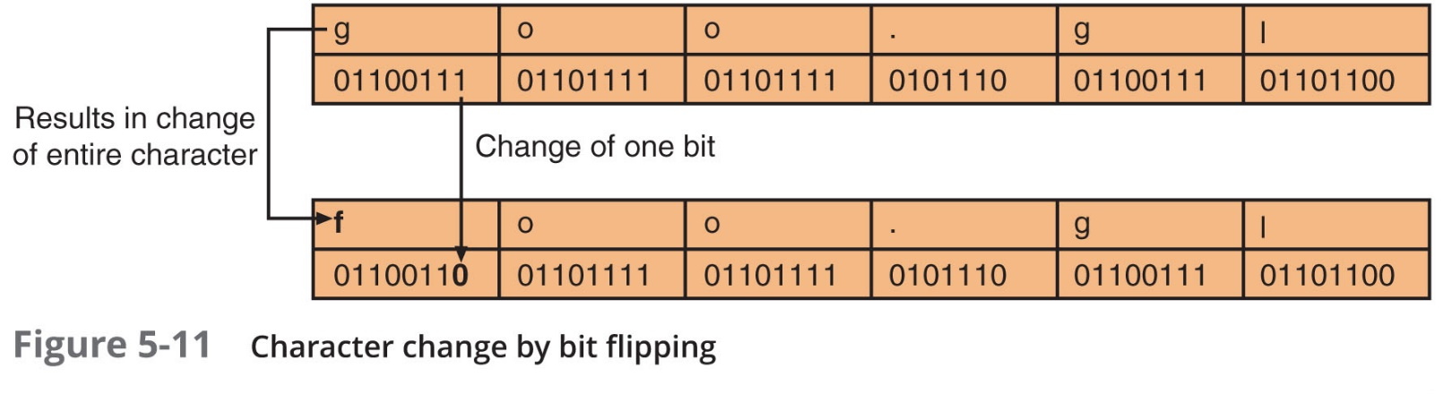
U R L Hijacking
U R L hijacking (also called typo squatting)
Users are directed to a fake look-alike site filled with ads for which the attacker receives money for traffic generated to the site
Attackers purchase the domain names of sties that are spelled similarly to actual sites
Threat actors are also registering domain names that are one bit different (called bitsquatting)

Slide 38
Domain Hijacking
Domain hijacking occurs when a domain pointer that links a domain name to a specific web server is changed by a threat actor
When a domain is hijacked
A threat actor gains access to the domain control panel and redirects the registered domain to a different physical web server

Slide 39
Clickjacking
Clickjacking
Hijacking a mouse click
The user is tricked into clicking a link that is other than what it appears to be
Clickjacking often relies upon threat actors who craft a zero-pixel I Frame
I Frame (short for inline frame) is an H T M L element that allows for embedding another H T M L document inside the main document
A zero-pixel I Frame is virtual invisible to the naked eye

Slide 40
Overflow Attacks
Overflow attacks
Designed to “overflow” areas of memory with instructions from the attacker
Types of overflow attacks:
Buffer overflow attacks
Integer overflow attacks

Slide 41
Buffer Overflow (1 of 2)
Buffer overflow attacks
Occur when a process attempts to store data in R A M beyond the boundaries of a fixed-length storage buffer
Extra data overflows into adjacent memory locations
An attacker can overflow the buffer with a new address pointing to the attacker’s malware code

Slide 42
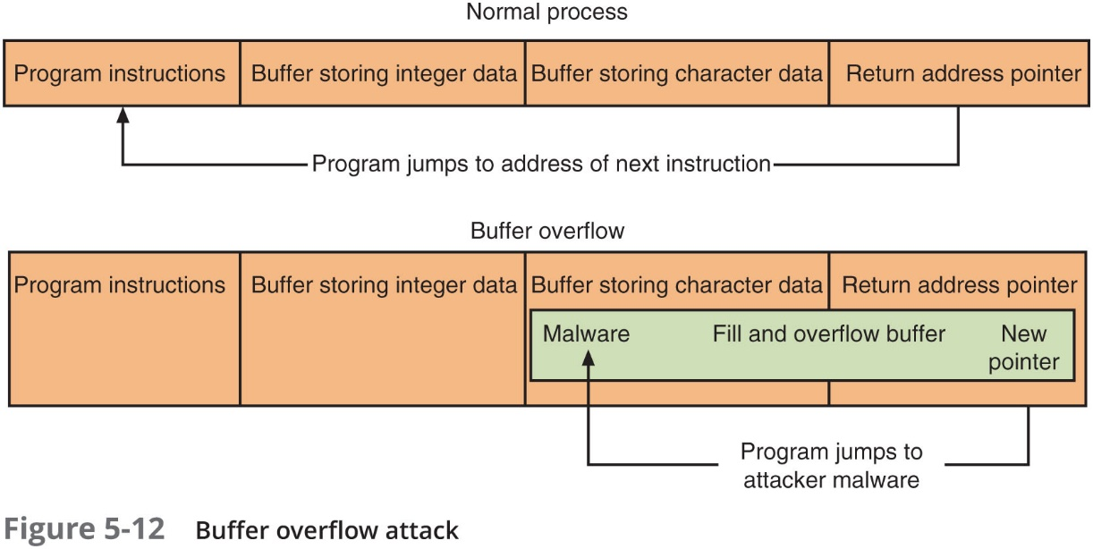
Buffer Overflow (2 of 2)

Slide 43
Integer Overflow
An integer overflow is the condition that occurs when the result of an arithmetic operation exceeds the maximum size of the integer type used to store it
In an integer overflow attack:
An attacker changes the value of a variable to something outside the range that the programmer had intended by using an integer overflow
This type of attack could be used in the following situations:
An attacker could use an integer overflow attack to create a buffer overflow situation
A program that calculates the total cost of items purchased would use the number of units sold times the cost per unit. If an integer overflow were introduced, it could result in a negative value and a resulting negative total cost
A large positive value in a bank transfer could be wrapped around by an integer overflow attack to become a negative value
Could reverse flow of money

Slide 44
Advertising Attacks
Several attacks attempt to use ads or manipulate the advertising system
Two of the most common:
Malvertising
Ad fraud

Slide 45
Malvertising
Threat actors use third-party advertising networks to distribute malware to unsuspecting users who visit a well-known site
Known as malvertising or a poisoned ad attack
An ad that contains malware redirects visitors who receive it to the attacker’s webpage that then downloads Trojans and ransomware onto the user’s computer
Preventing malvertising is difficult
Website operators are unaware of the types of ads that are being displayed
Users have a false sense of security going to a “mainstream” website
Turning off ads that support plug-ins such as Adobe Flash often disrupts the user’s web experience

Slide 46
Ad Fraud
Threat actors manipulate pre-roll ads to earn ad revenue that is directed back to them
Attackers have created a “robo-browser” called Methbot
That spoofs all the necessary interacted needed to initiate, carry out, and complete ad auctions

Slide 47
Browser Vulnerabilities
Web browser additions have introduced vulnerabilities in browsers that access servers
These additions are:
Extensions
Plug-ins
Add-ons

Slide 48
Scripting Code
Adding dynamic content
Web server downloads a “script” or series of instructions in the form of computer code that commands the browser to perform specific actions
JavaScript is the most popular scripting code
JavaScript instructions are embedded inside H T M L documents
There are different defense mechanisms intended to prevent JavaScript programs from causing serious harm
However, there are security concerns
A malicious JavaScript program could capture and remotely transmit user information without the user’s knowledge or authorization

Slide 49
Extensions
Extensions expand the normal capabilities of a web browser
For a specific webpage
Most extensions are written in JavaScript
So that the browser can support dynamic actions
Extensions are browser dependent
An extension that works in Google Chrome will not function in Microsoft Edge

Slide 50
Plug-Ins (1 of 2)
Plug-in
Adds new functionality to a web browser so users can play music, view videos, or display special graphical images
A single plug-in can be used on different web browsers
One common plug-in supports Java
Java can be used to create a separate program called a Java applet
Most widely used plug-ins for web browsers:
Java, Adobe Flash player, Apple QuickTime, and Adobe Acrobat Reader

Slide 51
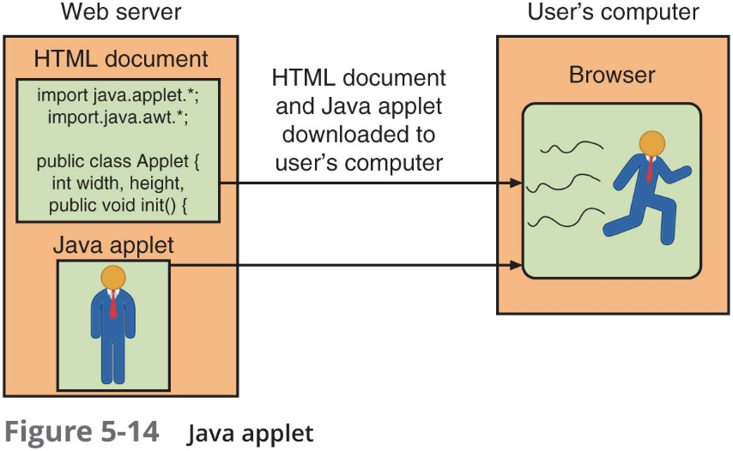
Plug-Ins (2 of 2)

Slide 52
Add-Ons (1 of 2)
Add-ons
Add a greater degree of functionality to the web browser
Add-ons can do the following:
Create additional web browser toolbars
Change browser menus
Be aware of other tabs open in the same browser
Process the content of every webpage that is loaded
Due to the risks associated with extensions, plug-ins, and add-ons
Efforts are being made to minimize them
Some web browsers now block plug-ins
H T M L 5 standardizes sound and video formats so that plug-ins like Flash are no longer needed

Slide 53
Add-Ons (2 of 2)
Name | Description | Location | Browser support | Examples
Extension | Written in JavaScript and has wider access to privileges | Part of web browser | Only works with a specific browser | Download selective links on webpages, display specific fonts
Plug-in | Links to external programs | Outside of web browser | Compatible with many different browsers | Audio, video, P D F file display
Add-on | Adds functionality to browser itself | Part of the web browser | Only works with a specific browser | Dictionary and language packs

Slide 54
Chapter Summary (1 of 2)
Some attacks are designed to intercept network communications
Man-in-the-middle and replay attacks are examples
Some types of attacks inject “poison” into a normal network process to facilitate an attack
Whereas some attacks are directed at the network itself, other attacks are directed at network servers
Denial of service, D N S amplification attack, and S Y N flood attack are examples
A cross-site scripting (X S S) attack is focused not on attacking a web application server, but on using the server to launch other attacks on computers that access it

Slide 55
Chapter Summary (2 of 2)
Several server attacks are the result of threat actors “commandeering” a technology and then using it for an attack
Some attacks can target either a server or a client by “overflowing” areas of memory with instructions from the attacker
Most websites today rely heavily upon advertising revenue
Several attacks attempt to use ads or manipulate the advertising system
To provide enhanced features, virtually all websites today allow scripting code to be downloaded from the web server into the user’s web browser

